Slide 1
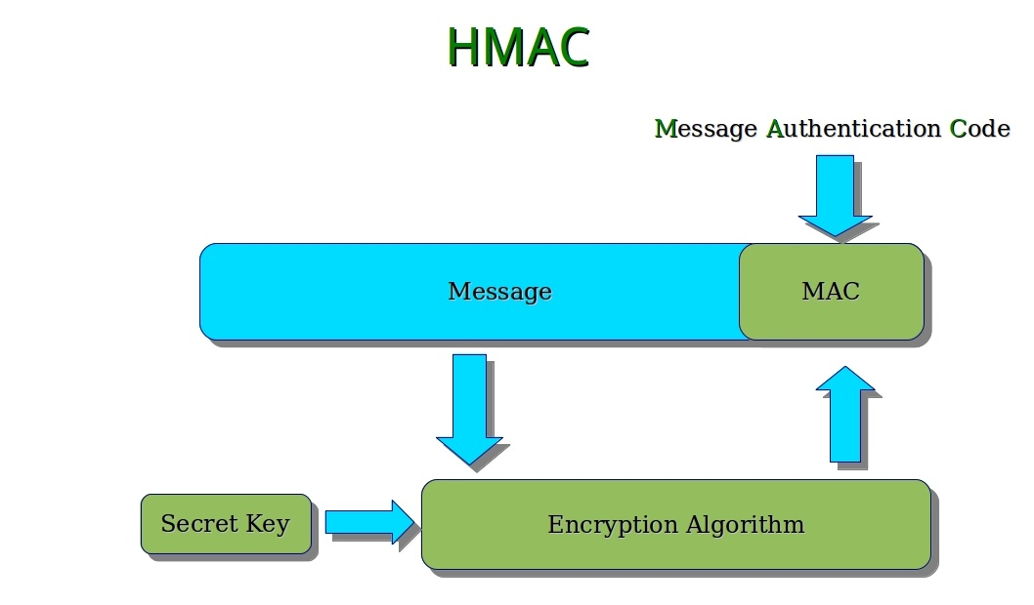
HMAC and Key Derivation
MAC, HMAC and Key Derivation Functions

Slide 2
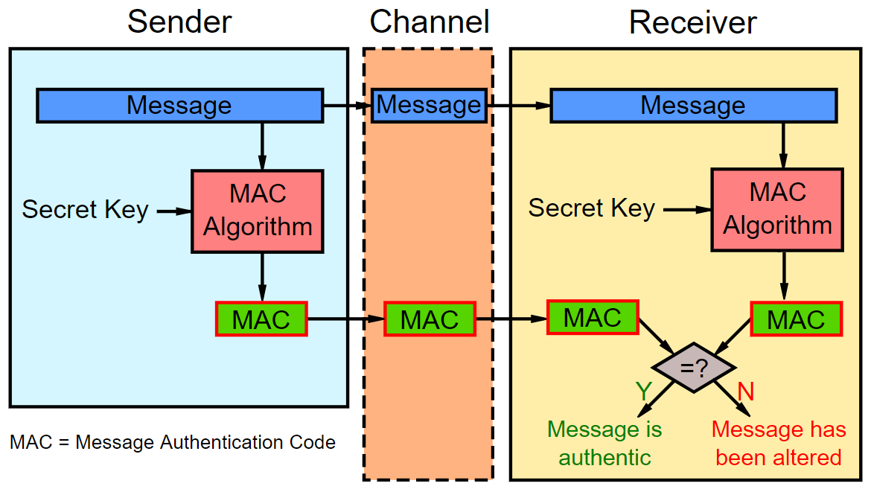
Message Authentication Code (MAC)
Message Authentication Code: auth_code = MAC(key, msg)
Digital authenticity code, like a signature, but with pre-shared key
When we need MAC?
We have a pre-shared key
We get a msg + auth_code
We want to be sure the msg is not tampered (both key and msg are correct)
Pseudo-random generator: next_seed = MAC(salt, seed)

Slide 3
HMAC and Key Derivation
Simply calculating hash_func(key + msg) is insecure
Use a secure HMAC algorithm instead, e.g. HMAC-SHA256
HMAC = Hash-based Message Authentication Code
HMAC(key, msg, hash_func) → hash
Message hash mixed with a secret shared key
Used for message authenticity / integrity / key derivation
Key derivation function (KDF) == function(password) → key
Use HKDF (HMAC-based key derivation), PBKDF2 or SCrypt

Slide 4
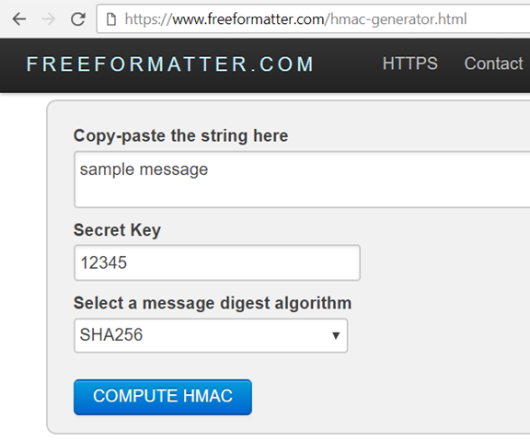
HMAC
Live Demo
https://www.freeformatter.com/hmac-generator.html

Slide 5
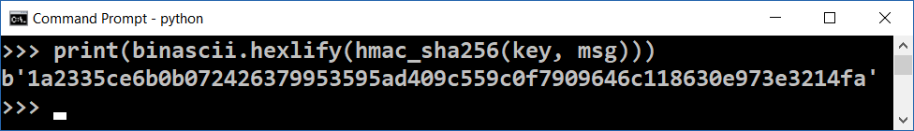
HMAC Calculation in Python – Example
import hashlib, hmac, binascii
def hmac_sha256(key, msg):
return hmac.new(key, msg, hashlib.sha256).digest()
key = binascii.unhexlify("fa63f2b4c85af6bed3")
msg = "some message".encode("utf8")
print(binascii.hexlify(hmac_sha256(key, msg)))

Slide 6

HMAC and Key Derivation
Try the Code!

